Slide 1
Modeling Social Data: Causality and Experiments
Guest lecturers: Andrew Mao, Amit Sharma

Slide 2
Intro to Causal Inference
Amit #1
Notes:
We have seen social data..descriptive..but want to know what policies to activate?

Slide 3
Prediction
Make a forecast, leaving the world as it is
(seeing my neighbor with an umbrella might predict rain)
vs.
Causation
Anticipate what will happen when you make a change in the world
(but handing my neighbor an umbrella doesn’t cause rain)

Slide 4
“Causes of effects”
It’s tempting to ask “what caused Y”, e.g.
What makes an email spam?
What caused my kid to get sick?
Why did the stock market drop?
This is ”reverse causal inference”, and is generally quite hard
John Stuart Mill (1843)

Slide 5
“Effects of causes”
Alternatively, we can ask “what happens if we do X?”, e.g.
How does education impact future earnings?
What is the effect of advertising on sales?
How does hospitalization affect health?
This is “forward causal inference”: still hard, but less contentious!
John Stuart Mill (1843)

Slide 6
Example: Hospitalization on health
What’s wrong with estimating this model from observational data?
Hospital visit today
Health tomorrow
Effect?
Arrow means “X causes Y”

Slide 7
Confounds
The effect and cause might be confounded by a common cause, and be changing together as a result
Health today
Hospital visit today
Health tomorrow
Effect?
Dashed circle means “unobserved”

Slide 8
Confounds
If we only get to observe them changing together, we can’t estimate the effect of hospitalization changing alone
Health today
Hospital visit today
Health tomorrow
Effect?

Slide 9
Observational estimates
Let’s say all sick people in our dataset went to the hospital today, and healthy people stayed home
The observed difference in health tomorrow is:
Δ_{obs} = (Sick and went to hospital) – (Healthy and stayed home)

Slide 10
Observational estimates
Let’s say all sick people in our dataset went to the hospital today, and healthy people stayed home
The observed difference in health tomorrow is:
Δ_{obs} = [(Sick and went to hospital) – (Sick if stayed home)] +
[(Sick if stayed home) - (Healthy and stayed home)]

Slide 11
Selection bias
Let’s say all sick people in our dataset went to the hospital today, and healthy people stayed home
The observed difference in health tomorrow is:
Δ_{obs} = [(Sick and went to hospital) – (Sick if stayed home)] +
[(Sick if stayed home) - (Healthy and stayed home)]
Causal effect
Selection bias
(Baseline difference between those who opted in to the treatment and those who didn’t)

Slide 12
Basic identity of causal inference
Let’s say all sick people in our dataset went to the hospital today, and healthy people stayed home
The observed difference in health tomorrow is:
Observed difference = Causal effect – Selection bias
Selection bias is likely negative here, making the observed difference an underestimate of the causal effect

Slide 13
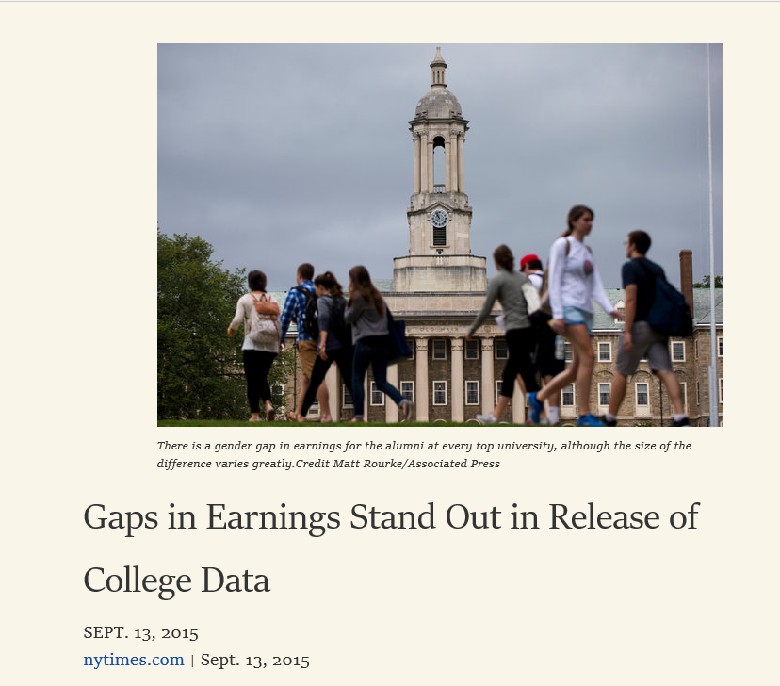
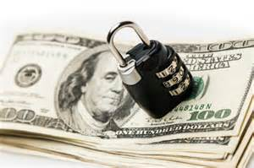
A fundamental problem across science and industry
Knowledge (Science)
What is the effect of doing X?
Social sciences
Biology and medicine
Solving problems (Industry)
When should I do X?
Predictive models in practice
Policies for better outcomes

Slide 14

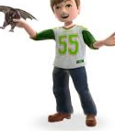
How do predictive systems work?
Aim: Predict future activity for a user.
We see data about their user profile and past activity.
E.g., for any user, we might see their age, gender, past activity and their social network.
…

Slide 15
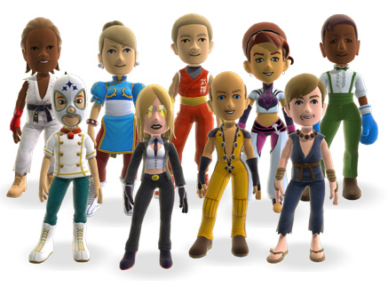
From data to prediction
Higher Activity Lower Activity
✗
Use these correlations to make a predictive model.
Future Activity ->
f(number of friends, logins in past month)

Slide 16
From data to “actionable insights”
Number of friends can predict activity with high accuracy.
How do we increase activity of users?
Would increasing the number of friends increase people’s activity on our system?
Maybe, may be not (!)

Slide 17
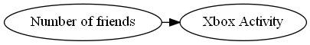
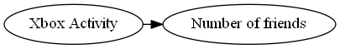
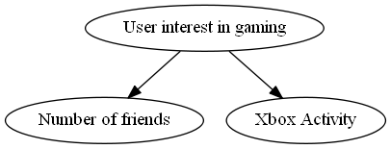
Different explanations are possible
How do we know
what causes what?
Decision: To increase activity, would it make sense to launch a campaign to increase friends?

Slide 18


Another example: Search Ads
Search engines uses ad targeting to show relevant ads.
Prediction model based on user’s search query.
Search Ads have the highest click-through rate (CTR) in online ads.

Slide 19
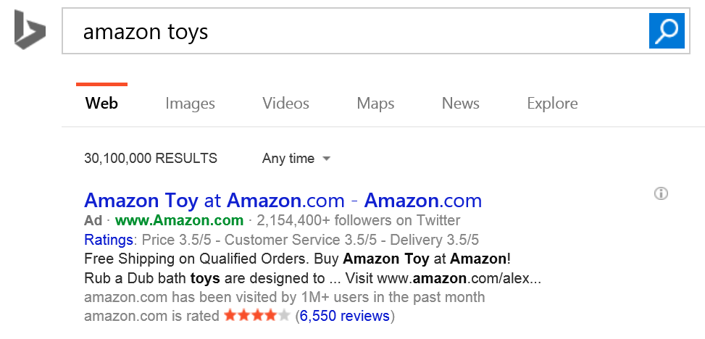
Are search ads really that effective?
Ad targeting was highly accurate.
Blake-Tadelis-Noskos (2014)

Slide 20
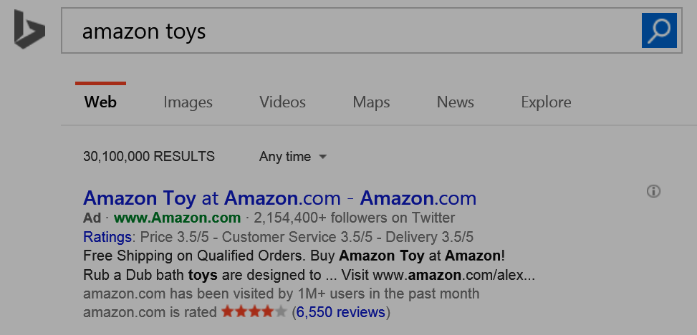
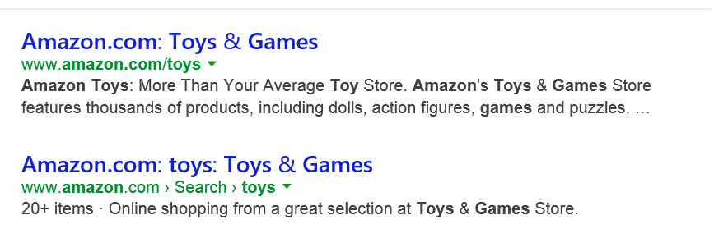
But search results point to the same website
Counterfactual question: Would I have reached Amazon.com anyways, without the ad?

Slide 21
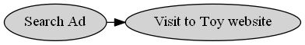
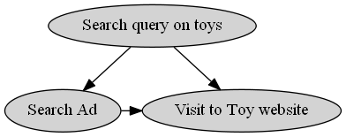
Without reasoning about causality, may overestimate effectiveness of ads
x% of ads shown are effective
<x% of ads shown are effective

Slide 22
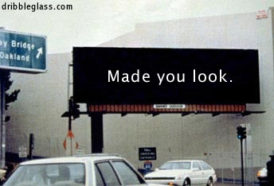
Okay, search ads have an explicit intent. Display ads should be fine?
Probably not.
There can be many hidden causes for an action, some of which may be hard to quantify.

Slide 23
So far, so good. Be mindful of hidden causes, or else we might overestimate causal effects.

Slide 24
(But) Ignoring hidden causes can also lead to completely wrong conclusions.

Slide 25
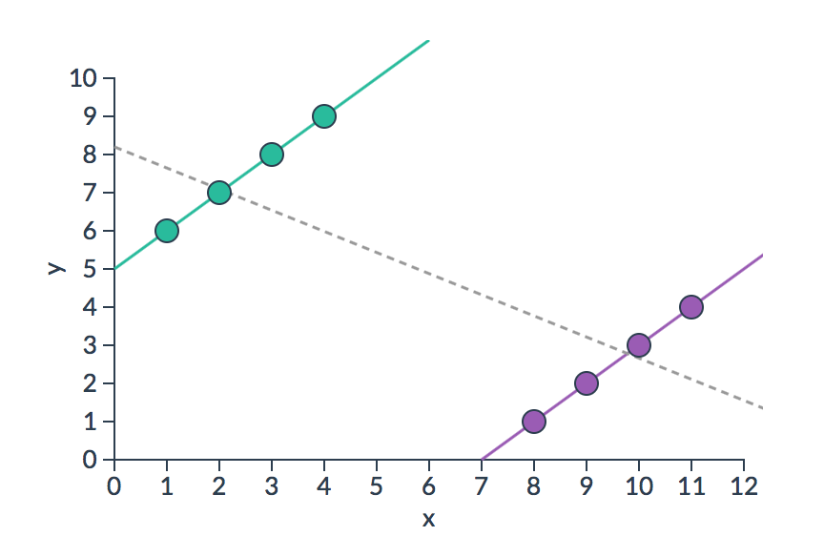
Simpson’s paradox
Selection bias can be so large that observational and causal estimates give opposite effects (e.g., going to hospitals makes you less healthy)
http://vudlab.com/simpsons

Slide 26
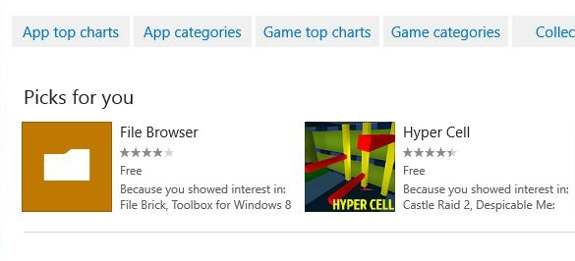
Example: Which algorithm is better?
Have a current production algorithm. Want to test if a new algorithm is better.
Say recommendations on app store.
?
Algorithm A
Algorithm B

Slide 27
Comparing old versus new algorithm
Two algorithms, A (production) and B (new) running on the system.
From system logs, collect data for 1000 sessions for each. Measure CTR.
Old Algorithm (A) | New Algorithm (B)
50/1000 (5%) | 54/1000 (5.4%)
New algorithm is better?

Slide 28
Frequent users of the Store tend to be different from new users
So let us look at
CTR separately.
Old Algorithm (A) | New Algorithm (B)
10/400 (2.5%) | 4/200 (2%)
Low-activity Users
Old Algorithm (A) | New Algorithm (B)
40/600 (6.6%) | 50/800 (6.2%)
High-activity Users

Slide 29
The Simpson’s paradox
 | Old algorithm (A) | New Algorithm (B)
CTR for Low-Activity users | 10/400 (2.5%) | 4/200 (2%)
CTR for High-Activity users | 40/600 (6.6%) | 50/800 (6.2%)
Total CTR | 50/1000 (5%) | 54/1000 (5.4%)
Is Algorithm A better?
Simpson (1951)

Slide 30
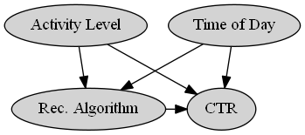
Answer (as usual): May be, may be not.
E.g., Algorithm A could have been shown at different times than B.
There could be other hidden causal variations.

Slide 31
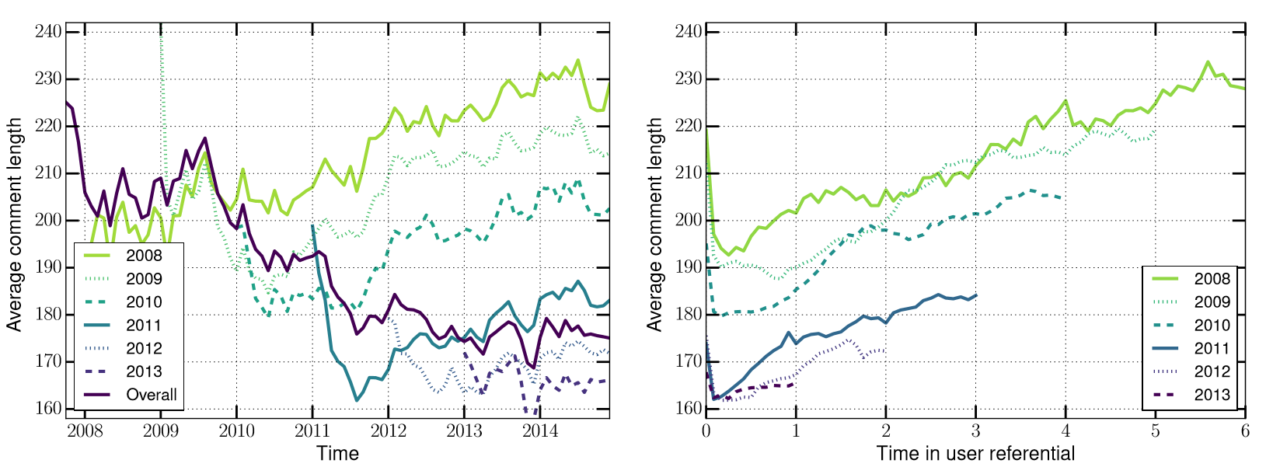
Example: Simpson’s paradox in Reddit
Average comment length decreases over time.
But for each yearly cohort of users, comment length increases over time.
Barbosa-Cosley-Sharma-Cesar (2016)

Slide 32
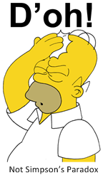
Making sense of such data can be too complex.

Slide 33
Intro to Experiments
Andrew #1

Slide 34
“To find out what happens when you change something, it is necessary to change it.”
-George Box

Slide 35



Counterfactuals
To isolate the causal effect, we have to change one and only one thing (hospital visits), and compare outcomes
Reality
Counterfactual
+
vs
(what happened)
(what would have happened)

Slide 36
Counterfactuals
We never get to observe what would have happened if we did something else, so we have to estimate it
Reality
Counterfactual
+
vs
(what happened)
(what would have happened)
Notes:
What we’d like to do is to make a copy of the world

Slide 37

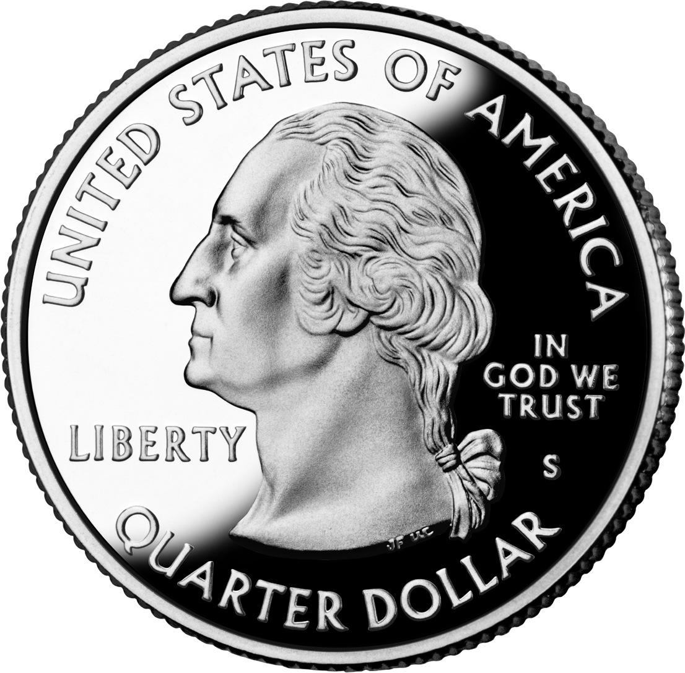
Random assignment
We can use randomization to create two groups that differ only in which treatment they receive, restoring symmetry
World 1
World 2
Heads
Tails
+

Slide 38

Random assignment
We can use randomization to create two groups that differ only in which treatment they receive, restoring symmetry
World 1
World 2
Heads
Tails
+

Slide 39
Random assignment
We can use randomization to create two groups that differ only in which treatment they receive, restoring symmetry
World 1
World 2
+

Slide 40
Basic identity of causal inference
The observed difference is now the causal effect:
Observed difference = Causal effect – Selection bias
= Causal effect
Selection bias is zero, since there’s no difference, on average, between those who were hospitalized and those who weren’t

Slide 41
Random assignment
Random assignment determines the treatment independent of any confounds
Health today
Coin flip
Hospital visit today
Health tomorrow
Effect?
Double lines mean “intervention”

Slide 42
Experiments: Caveats / limitations
Random assignment is the “gold standard” for causal inference, but it has some limitations:
Randomization often isn’t feasible and/or ethical
Experiments are costly in terms of time and money
It’s difficult to create convincing parallel worlds
Inevitably people deviate from their random assignments
Anyone can flip a coin, but it’s difficult to create convincing parallel worlds

Slide 43
Two goals for experiments
Internal validity:
External validity (Generalization)
Could anything other than the treatment (i.e. a confound) have produced this outcome?
Did doctors give the experimental drug to some especially sick patients (breaking randomization) hoping that it would save them?
Do the results of the experiment hold in settings we care about?
Would this medication be just as effective outside of a clinical trial, when usage is less rigorously monitored?

Slide 44
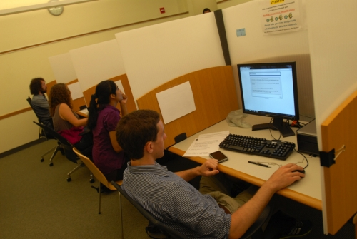
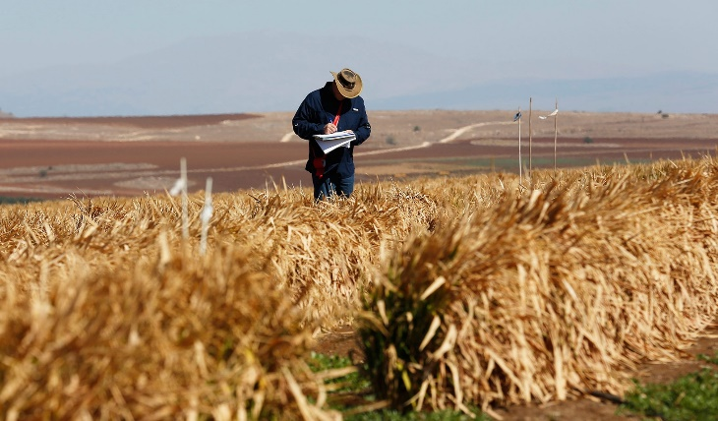
How we conduct behavioral experiments
Lab Experiment
Field Experiment
Better internal validity (correctness):
Greatest procedural control
Can carefully curate situations
But less external validity (generalization):
Artificial context, simple tasks
Demand effects
Homogeneous (WEIRD) subject pools
Time/scale limitations
Better generalization
Experiment findings apply to at least one real-world setting
But:
Less control, more potential confounds
Demand of experiment conflict with goals of real organizations
More effort to conduct and manage
More room for error
Notes:
Both experiments are pains in the butt to set up

Slide 45
Examples of Causal Inference
Amit #2

Slide 46
Natural experiments
Sometimes we get lucky and nature effectively runs experiments for us, e.g.:
As-if random: People are randomly exposed to water sources
Instrumental variables: A lottery influences military service
Discontinuities: Star ratings get arbitrarily rounded
Difference in differences: Minimum wage changes in just one state

Slide 47
Natural experiments
Sometimes we get lucky and nature effectively runs experiments for us, e.g.:
As-if random: People are randomly exposed to water sources
Instrumental variables: A lottery influences military service
Discontinuities: Star ratings get arbitrarily rounded
Difference in differences: Minimum wage changes in just one state
Experiments happen all the time, we just have to notice them

Slide 48
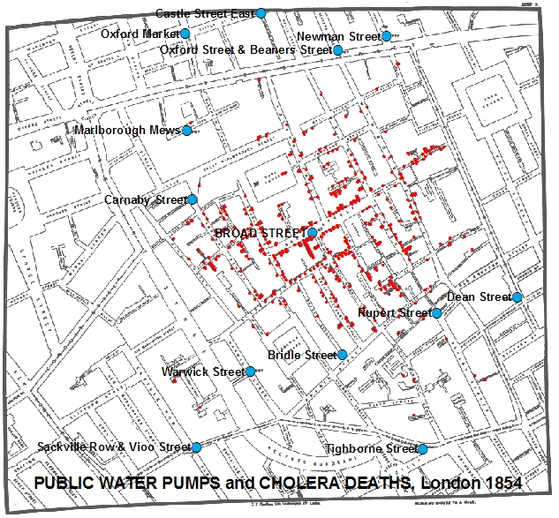
As-if random
Idea: Nature randomly assigns conditions
Example: People are randomly exposed to water sources (Snow, 1854)
http://bit.ly/johnsnowmap

Slide 49
Instrumental variables
Confounds
Idea: An instrument independently shifts the distribution of a treatment
Example: A lottery influences military service (Angrist, 1990)
Lottery
Military service
Future earnings
Effect?

Slide 50
Regression discontinuities
Idea: Things change around an arbitrarily chosen threshold
Example: Star ratings get arbitrarily rounded (Luca, 2011)
http://bit.ly/yelpstars

Slide 51
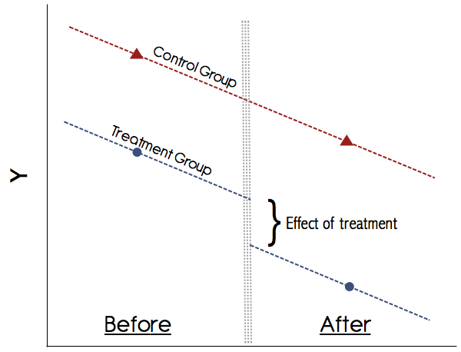
Difference in differences
Idea: Compare differences after a sudden change with trends in a control group
Example: Minimum wage changes in just one state (Card & Krueger, 1994)
http://stats.stackexchange.com/a/125266

Slide 52
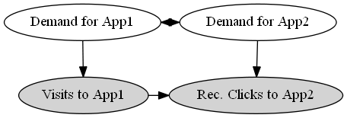
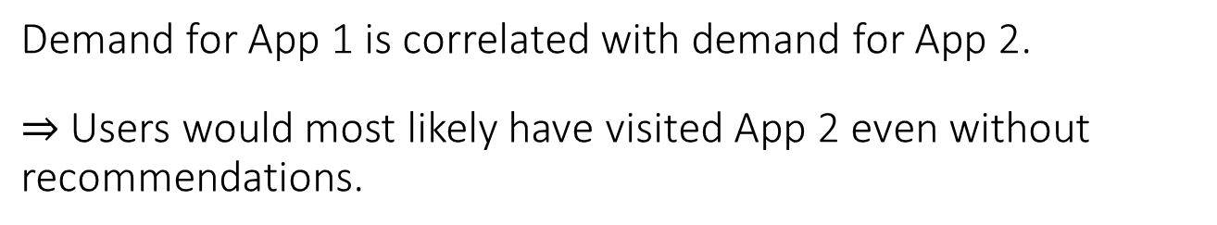
Cont. example: Effect of store recommendations
How many new visits are caused by the recommender system?
Demand for App 1 is correlated with demand for App 2.
$⇒$ Users would most likely have visited App 2 even without recommendations.

Slide 53
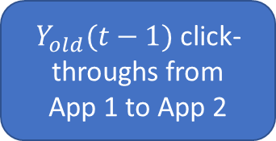
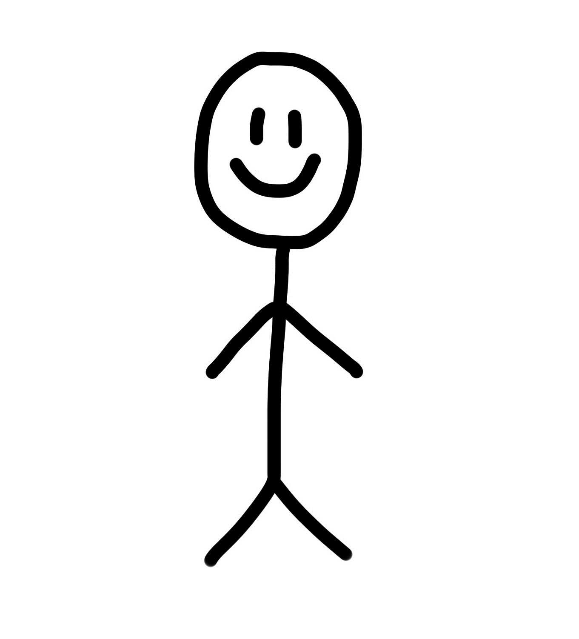
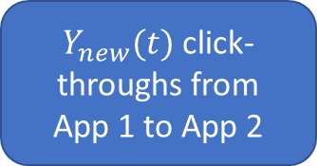
Traffic on normal days to App 1
$Y_{old}(t−1)$ click-throughs from
App 1 to App 2
Cannot say much about the causal effect of recommendations from App 1.
$Y_{new}(t)$ click-throughs from
App 1 to App 2

Slide 54
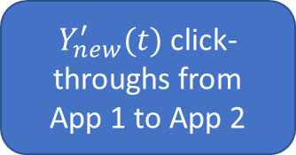
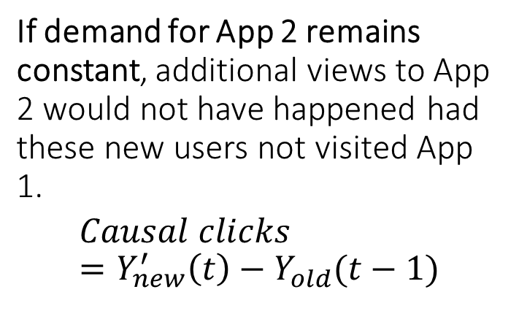
External shock brings as-if random users to App1
$Y_{old}(t−1)$ click-throughs from
App 1 to App 2
Spike in visits to App 1
If demand for App 2 remains constant, additional views to App 2 would not have happened had these new users not visited App 1.
$$Causal clicks =Y_{new}^{′}\left(t\right)−Y_{old}(t−1)$$
$Y_{new}^{′}(t)$ click-throughs from
App 1 to App 2
Sharma-Hofman-Watts (2015)

Slide 55
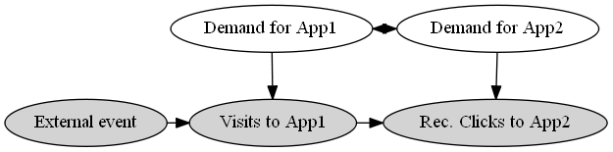
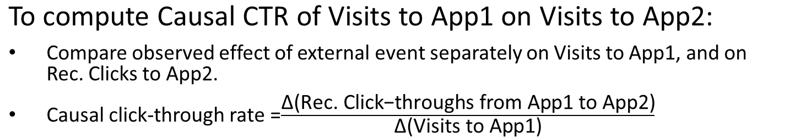
Exploiting sudden variation in traffic to App 1
To compute Causal CTR of Visits to App1 on Visits to App2:
Compare observed effect of external event separately on Visits to App1, and on Rec. Clicks to App2.
Causal click-through rate =$\frac{\text{Δ}\text{(}\text{Rec}\text{. }\text{Click}\text{−}\text{throughs} \text{from} \text{App}\text{1 }\text{to} \text{App}\text{2)}}{\text{Δ}\text{(}\text{Visits} \text{to} \text{App}\text{1)}}$

Slide 56
Natural experiments: Caveats
Natural experiments are great, but:
Good natural experiments are hard to find
They rely on many (untestable) assumptions
The treated population may not be the one of interest

Slide 57
Natural experiments: Caveats
Natural experiments are great, but:
Good natural experiments are hard to find
They rely on many (untestable) assumptions
The treated population may not be the one of interest
Sometimes we can use additional data + algorithms to automatically find natural experiments

Slide 58
What can we do without an experiment or natural experiment?
Condition on the “right” variables
How to find the right variables?
No good answer
Depends on domain knowledge
Many different frameworks (e.g. Pearlian graphical models and do-calculus)

Slide 59
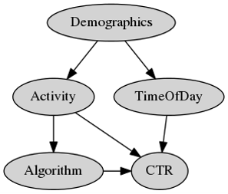
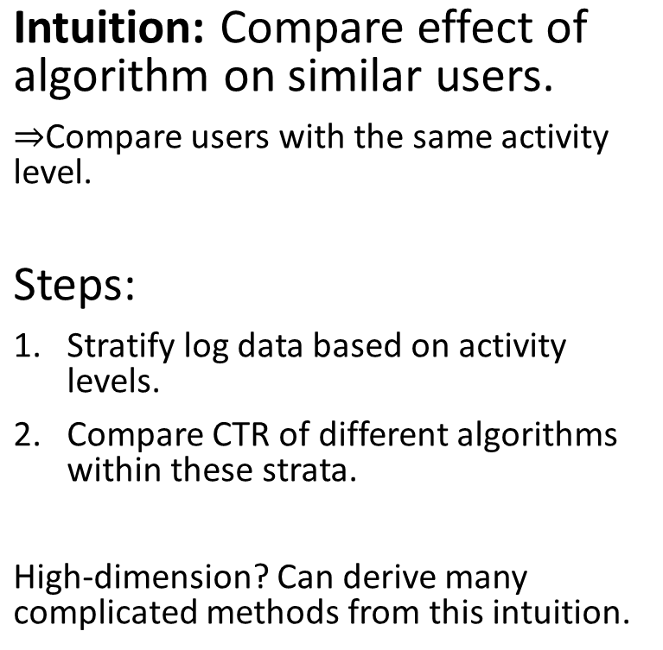
General method: Conditioning on variables
Intuition: Compare effect of algorithm on similar users.
$⇒$Compare users with the same activity level.
Steps:
Stratify log data based on activity levels.
Compare CTR of different algorithms within these strata.
High-dimension? Can derive many complicated methods from this intuition.

Slide 60
Examples of Experiments and Demo
Andrew #2

Slide 61
Behavioral science labs are very limiting
High degree of procedural control
Optimized for causal inference
But, many limitations:
Artificial environment
Simple tasks, demand effects
Homogeneous (WEIRD)* subject pools
Time/scale limitations
Expensive, difficult to set up
Poor generalization, expensive, slow
ca. 1960s
ca. 2000s
* Western, Educated, Industrialized, Rich, Democratic [Henrich et al. 2010]
Notes:
Why experiments, particularly lab experiments, for decades?
From 1960s until now, mostly undergrads at universities (WH behavioral lab)
Lots of control, can construct environments, good internal validity - causal conclusions drawn from an experiment are correct. Causality is what we care about in design.
But curious setting: many limitations, including low generalization, logistical issues
One of the biggest limitations is that social science experiments not social

Slide 62
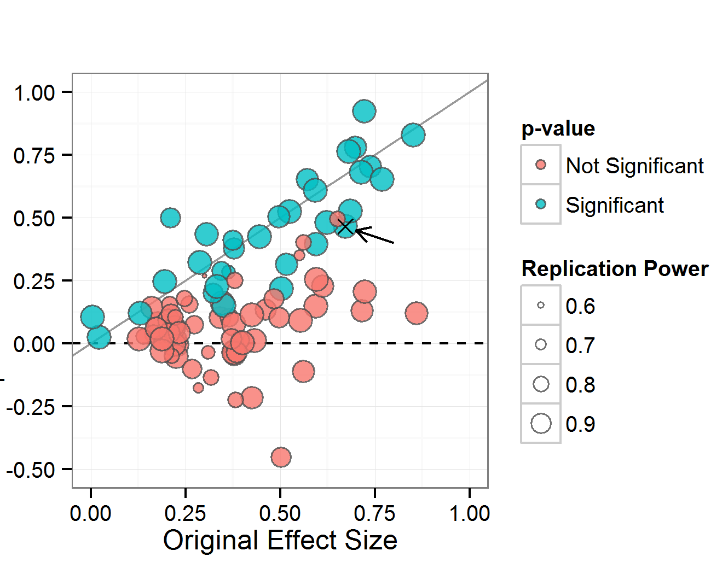
Experiments are underpowered
Two-thirds of psychology studies don’t replicate!
Estimating the Reproducibility of Psychological Science (2015)

Slide 63
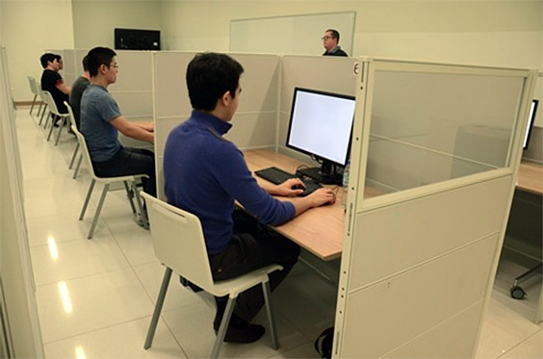
Most social science experiments aren’t social
Vast majority of experiments done with individuals, focused on individual behavior: logistically, it’s just easier
We actually don’t know the causal effects of policies in many large-scale, collective behavior settings!

Slide 64
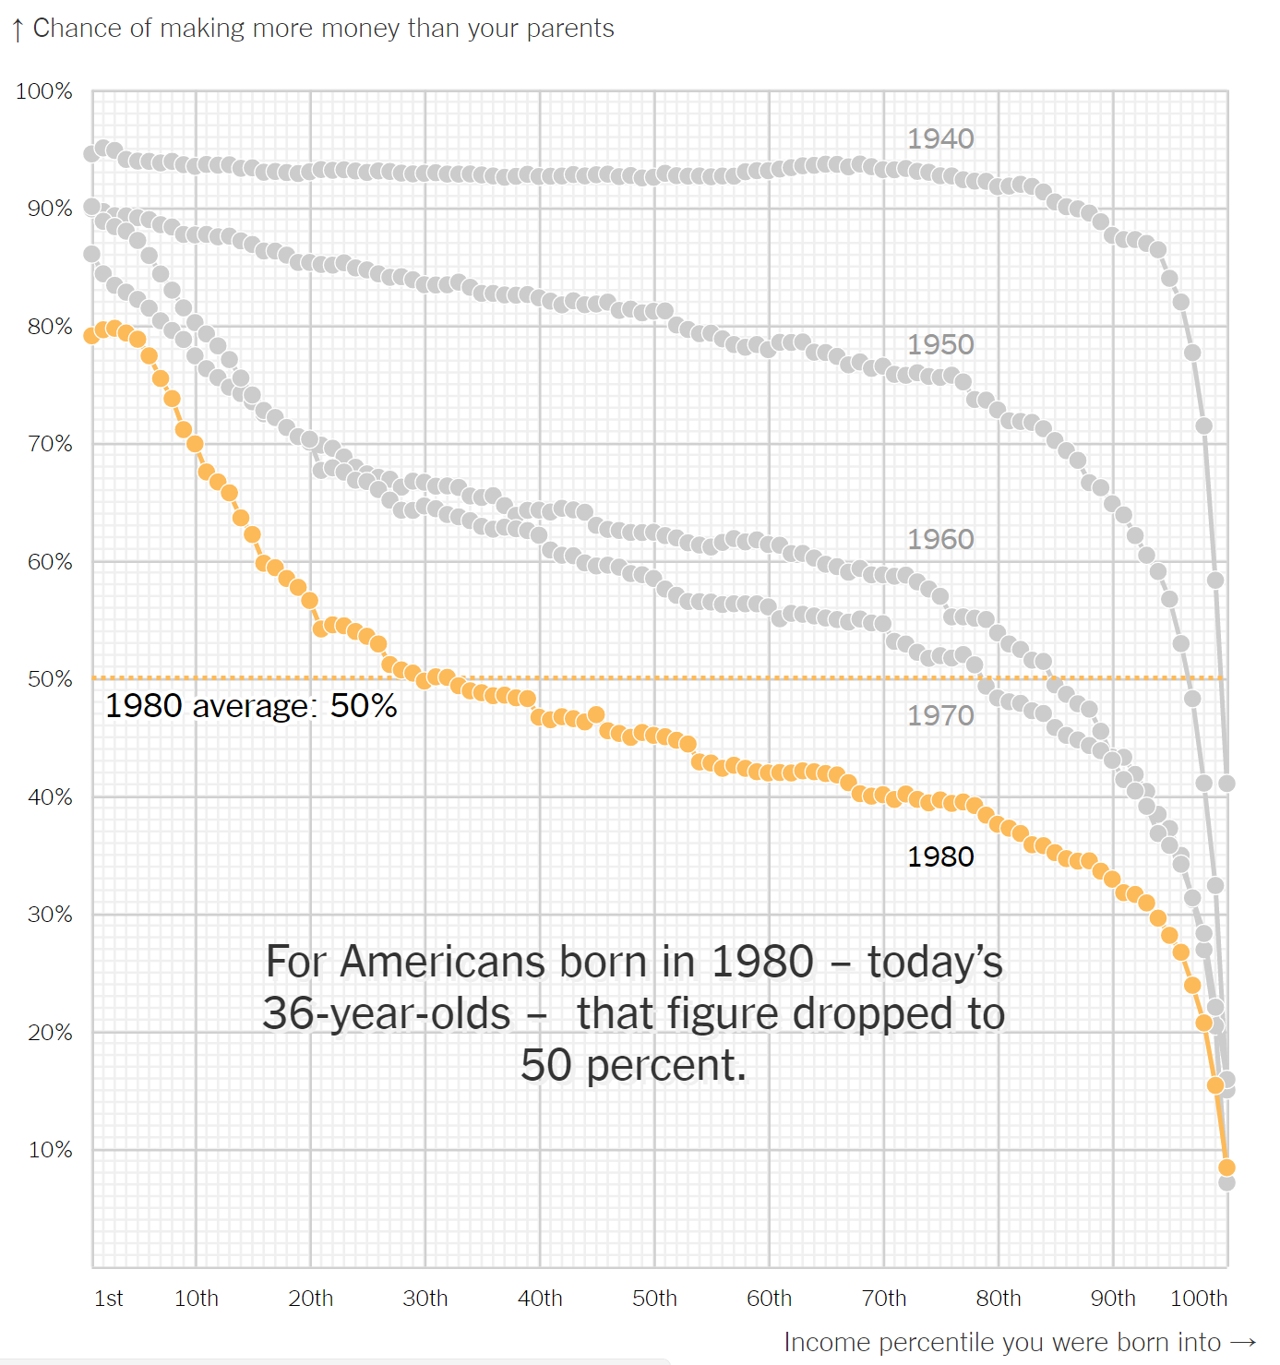
Economic Inequality
Social mobility: if you work hard, can you be more successful than your parents?
How do social safety nets, economic redistribution, etc. affect social mobility and resulting inequality?
What policies can we enact that will improve social mobility or reduce inequality?
The American Dream, Quantified at Last. NYTimes, Dec. 8 2016.
Notes:
Let’s talk a little about potential problems

Slide 65
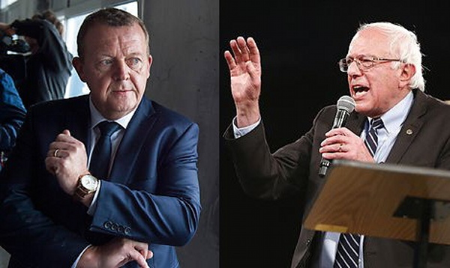
Systems of Governance
I think we should look to countries like Denmark, like Sweden and Norway, and learn from what they have accomplished for their working people
What would happen if we suddenly replaced our current political system with a Scandinavian “socialist state”?
Would everyone be happier?
Or would it be culturally untenable?
Notes:
Bernie sanders Denmark
Wealth redistribution

Slide 66
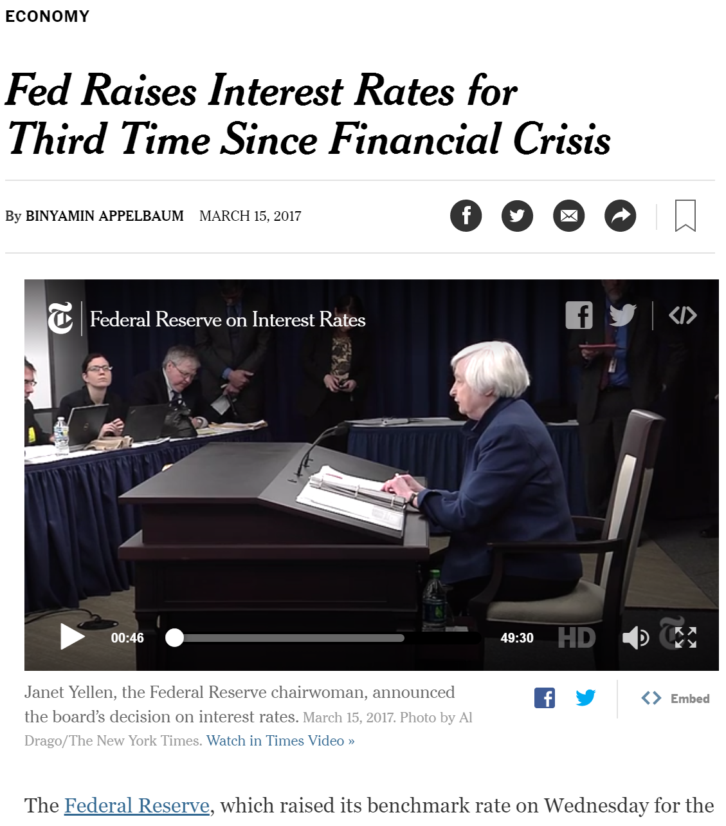
The black box of macroeconomic policy
There are no clear theories behind whether lowering interest rates, tightening interest rates, or quantitative easing work as intended.
Given a sufficiently large simulated economy, can we study these experimentally?

Slide 67
So, about them experiments…
They’re costly to run
Yet limited in the types of questions they can answer
Published experimental research is probably wrong
They’re far from answering many big important questions
How do we fix this?

Slide 68

Expanding the experiment design space
Complexity,
Realism
Realistic vs. abstract, simple tasks
More precise instrumentation
A software-based “virtual lab” with online participants
Duration, Participation
Physical labs
Longer periods of time
Fewer constraints on location
Size, Scale
More samples of data
Large-scale social interaction
Notes:
To study the crowd experimentally, we want social science experiments to be social
One way to think about the types of tasks we want to study is along different design axes
Physical labs are clustered around the origin; fall short – simple, abstract tasks; for short times; by undergrads in a small room
Our goal is to expand this using the Internet as a lab, controlled by software, using crowdsourcing
Potential to study many novel social problems, increasing our knowledge about how people interact, with each other and within computational systems

Slide 69
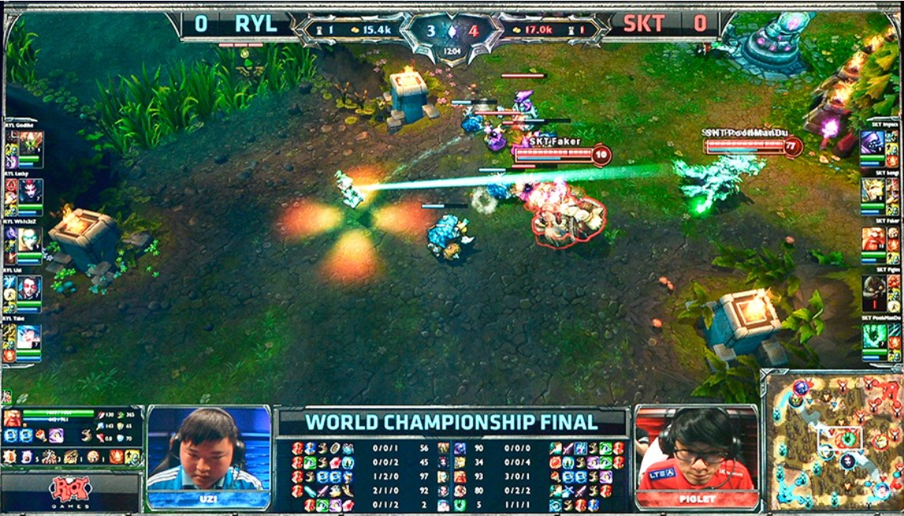

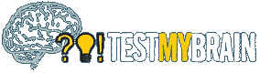
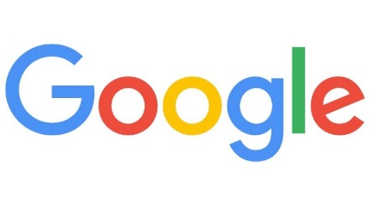
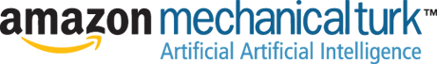
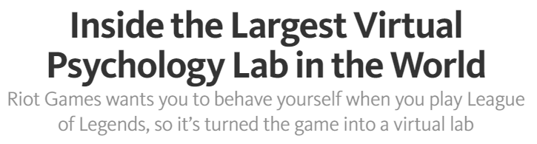
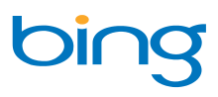
Behavioral experiments + the Internet
The Virtual Lab
Control
Generalization
Unwitting labs in the field
Volunteer
web labs
Notes:
This dichotomy changes when we have the Internet. I like to think of the Internet as basically replacing the binary lab/field distinction with a continuous spectrum.
Some of you, when thinking of virtual lab, might think of “Amazon Mechanical Turk”. But I would put that around here.
On the left we have things like TestMyBrain, an example of a web-based lab using pure volunteers. The amazing thing is that the volunteers have been enough to do 10^5 experiments.
All the way on the right, in the field, we have real systems like FB, Google, and Microsoft, which we know do experiments all the time on their users, although many of those are not scientifically interesting.
Interestingly, in the middle, there are some things that look like the field, but are actually set up much like a lab
This region on the spectrum is what I think of the virtual lab. We give up a bit of control, but get a lot more generalization from getting out of lab limitations. More importantly, we can choose where we design experiments on this spectrum.

Slide 70

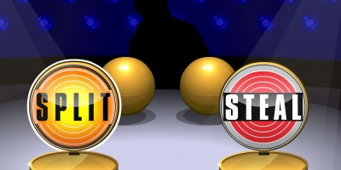
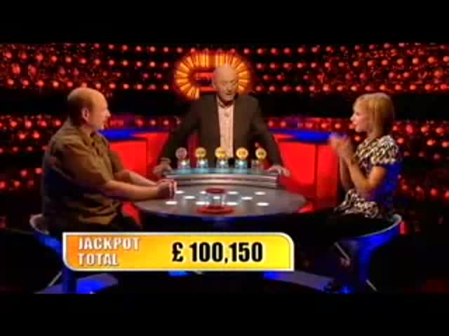
Prisoner’s
Dilemma
Cooperate
Defect
Split – Split | 50% - 50%
Steal – Split | 100% - 0%
Steal – Steal | 0% - 0%
Notes:
What is a social dilemma? Interests of the individual at odds of what’s best for everyone.
Many examples, but one of the fun ones comes from this British TV show called Golden Balls
You’re always no worse off if you steal.
This interaction looks very similar to a game called PD.
Tension between private incentive and public interest underlies many social and economic interactions, and that’s why PD is used to study cooperation.
Make a smoother transition to the next side – maybe overlay payoffs?

Slide 71
Q: What happens to people’s behavior when they are in a social dilemma for a long time?
Also known as: real life.
A: According to lab experiments, we don’t know. It seems like people start stabbing each other in the back when they play this game
…but the world seems to (mostly) be doing okay.

Slide 72

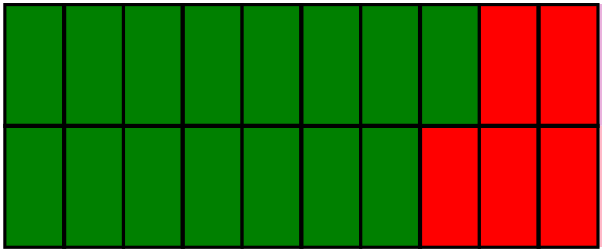
Longitudinal behavior in a social dilemma
anonymous
partners
Cooperate
Defect
Round 1
Round 10
Game
Notes:
That brings us to our experiment. We recruited about a hundred participants from MTurk and paired them to play 10 rounds of prisoner’s dilemma, many times.
I’ll call each set of 10 rounds a game.
Here’s an example of what players might do, where green represents cooperate and red means defect. The second player defected in round 8.
These players know that they have the same partner for 10 rounds, but their identity is anonymous.

Slide 73
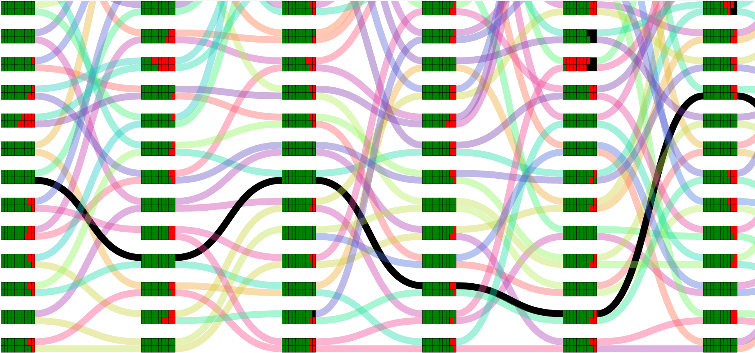
Random rematching across games
Game 1
Game 2
Game 3
Game 4
Game 5
Game 6
Notes:
Pairs of participants play many of these games simultaneously. After each set of games, we randomly re-match players with different partners and they play again
Black line shows all different partners for a player.
We do this so on for many games in each session, which takes place over a day.

Slide 74
Random rematching across games
Game 1
Game 2
Game 3
Game 4
Game 5
Game 6
Notes:
Pairs of participants play many of these games simultaneously. After each set of games, we randomly re-match players with different partners and they play again
identities are still anonymous but players know they have a new partner.
We do this so on for many games in each session, which takes place over a day.

Slide 75
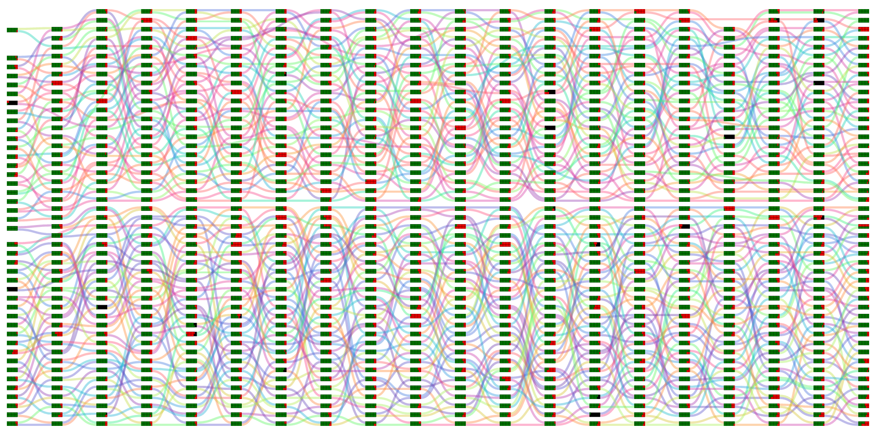
One experiment session – 20 games
50
pairs
Game 1
Game 20
Notes:
Each day has a total of 20 sets of games. We match players within a rather large pool, so that there are about 50 pairs of players for each set of games.

Slide 76




















Aug 4, 2015 – Day 1
Aug 31, 2015 – Day 20
Notes:
And finally, we did this every day for 20 weekdays in August.
This slide effectively shows all of the data from our experiment.
Even if you aren‘t interested in PD, this shows it’s possible to study interaction among 100 people over a month.

Slide 77
Demo time!
You get to play prisoner’s dilemma with each other!
The person with the most money at the end wins.
Navigate your laptop or mobile browser to:
http://skygeirr.andrewmao.net:3000
Notes:
Instead of just showing you this experiment, we’re going to do something really dangerous…a live demo.
Simple game showing all features of turkserver.

Slide 78
Demo
You will be the participants in this prisoner’s dilemma experiment!
Log in using the menu, choose “main”
Instructions: you will be playing IPD with repeated partners
Loses some context, so I will explain. (wait a bit)
Press begin when you are ready
Admin console; shows all user connections
Lobby, starting a game
Play some rounds with a partner; timeouts and stuff
Live experiments timer and graphs
Disconnections, slow players
One-way mirror of slow games – very useful to understand behavior
Visualization of data at end

Slide 79


A “supercollider” for social science
Realistic settings for collective behavior…
with precise instrumentation and measurement…
studied longitudinally over periods of time…
with a high degree of experimental control.
Notes:
Most social science isn’t social
We often can’t measure the data we’re interested in
We see stuff over time that we can’t in short studies
We want to be able to test theories causally
ScienceAtHome is very promising for this
Physics approach to social science
Mobile devices

Slide 80
Closing thoughts
Large-scale observational data is useful for building predictive models of a static world

Slide 81
Closing thoughts
But without appropriate random variation, it’s hard to predict what happens when you change something in the world

Slide 82
Closing thoughts
Randomized experiments are like custom-made datasets to answer a specific question

Slide 83
Closing thoughts
Additional data + algorithms can help us discover and analyze these examples in the wild

Slide 84

Causality is tricky!
“Correlation doesn’t imply causation, but it does waggle its eyebrows suggestively and gesture furtively while mouthing ‘look over there’”
https://www.xkcd.com/552/

